Slide 1
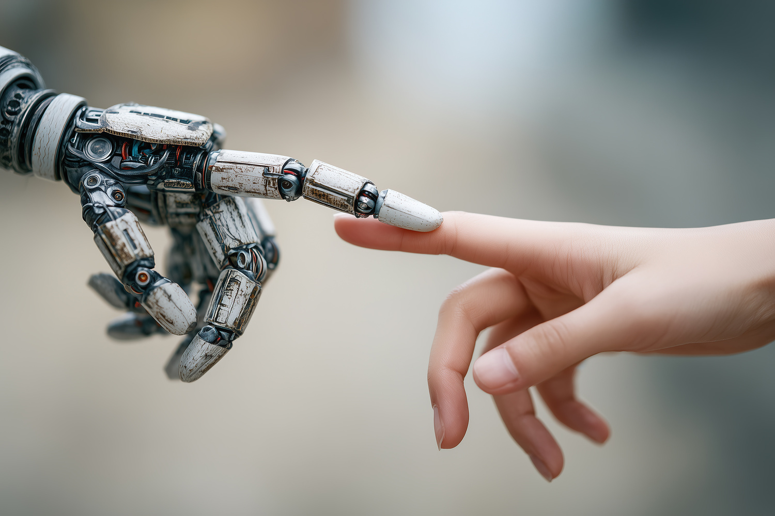
Introduction to Artificial Intelligence
Daniel Riofrío
Thanks to Luciana Valdivieso

Slide 2

What do we mean by intelligence?
The ability to understand or comprehend.
The ability to solve problems.
Knowledge, comprehension, the act of understanding.
The meaning that may be assigned to a proposition, saying, or expression.
Ability, skill, and experience.
What do we mean by Artificial Intelligence?
1700
. . .
. . .
. . .
2026
Initial Ideas
Generative AI LLMs - Agents

Slide 3
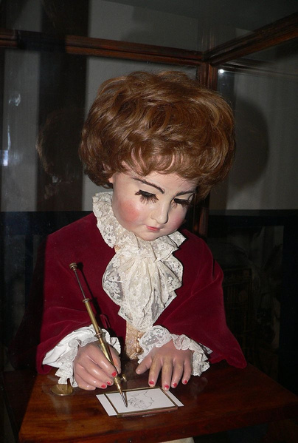
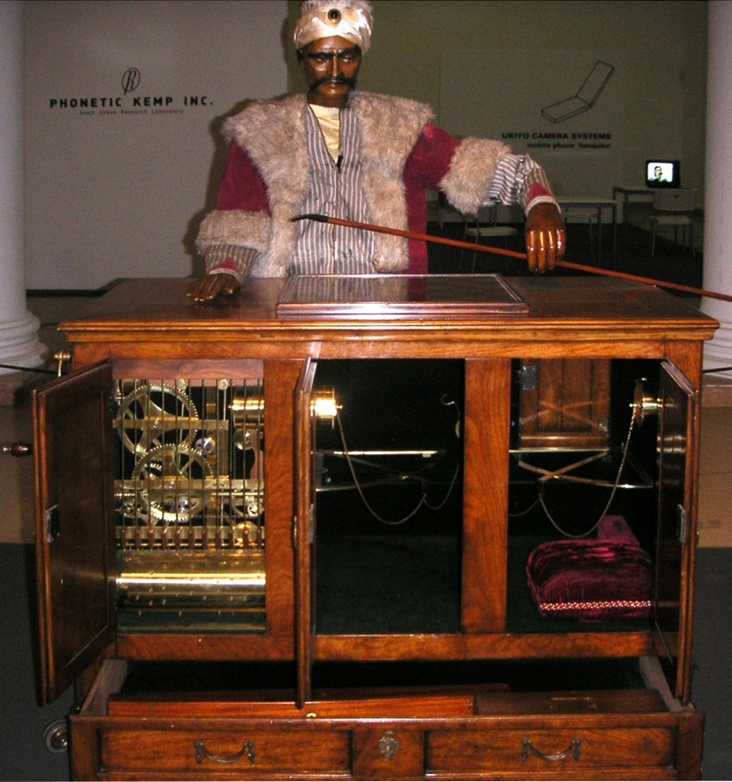
1768–1774 — Mechanical Automata
Built by the Swiss watchmaker Pierre Jaquet-Droz.
The musician, the draughtsman, and the writer
1700
1770 — The Mechanical Turk
Built by Wolfgang von Kempelen, it was a machine that appeared to play chess at a high level against a human opponent.

Slide 4
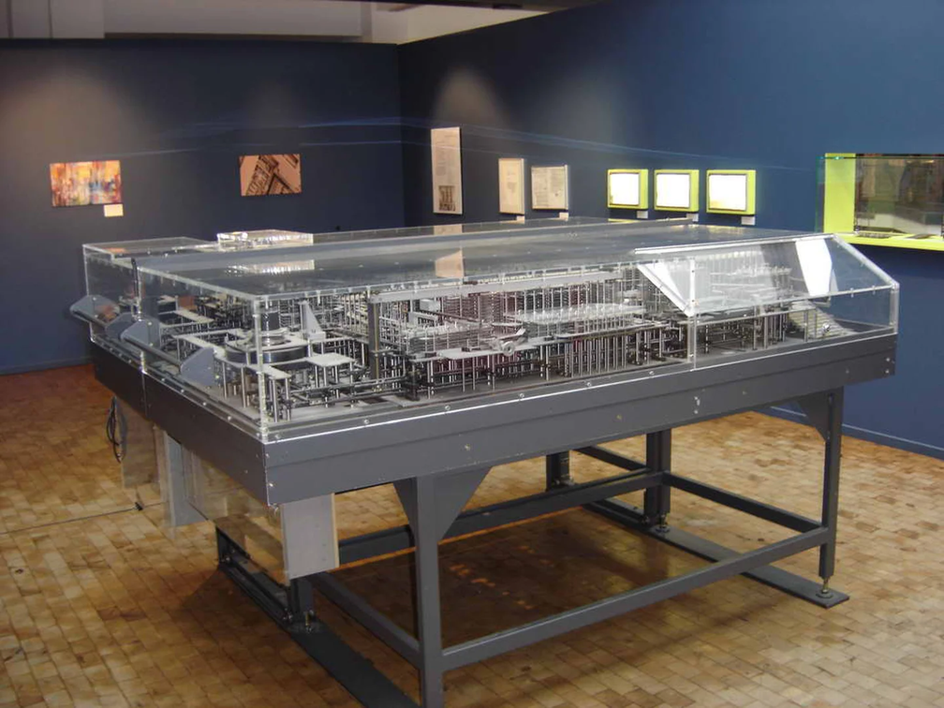
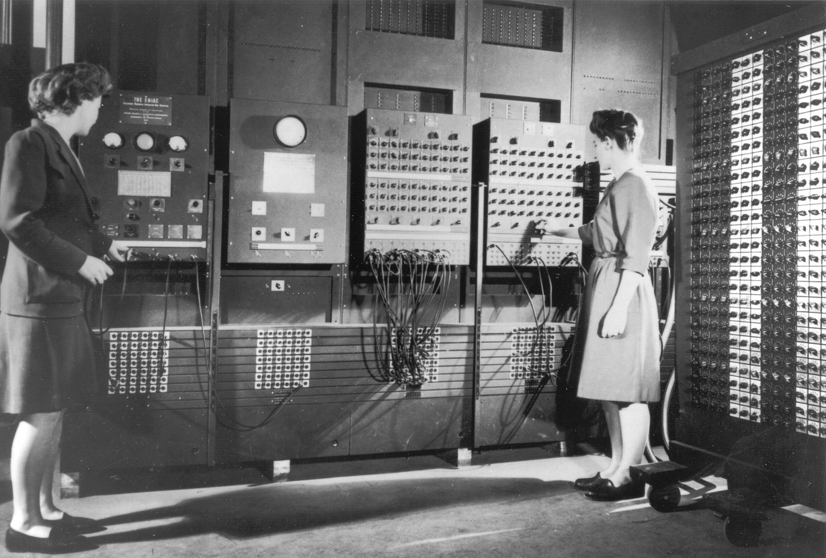
First Computer (Z1)
Designed by Konrad Zuse (Germany).
A binary calculator that read the operations it had to perform from punched cards.
It could perform addition, subtraction, multiplication, and division
Using floating-point arithmetic, and it had storage memory.
1936
First Universal Computer — ENIAC
Electronic Numerical Integrator and Computer
One of the first general-purpose computers.
Programmable; used vacuum tubes.
Floor area: 170 m²
Weight: 27 metric tons.
Used for mathematical calculations.
1945

Slide 5
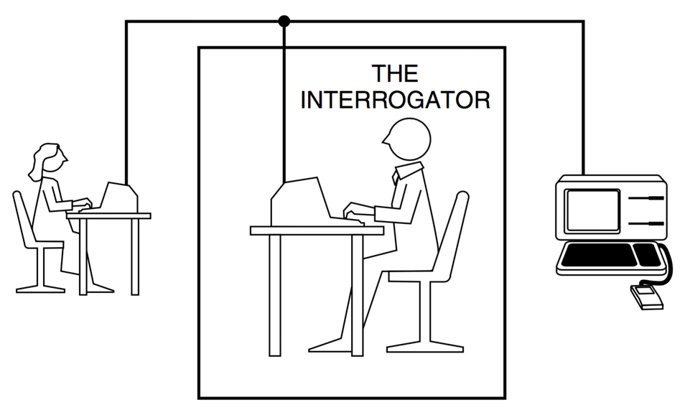
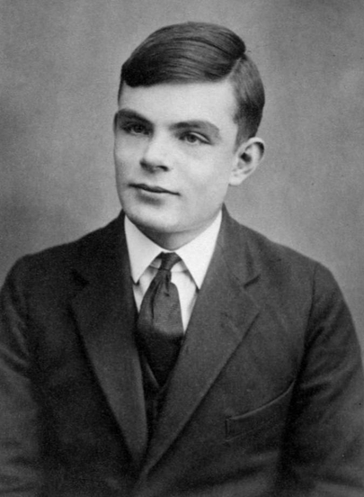
1950
Components: 2 humans and one computer.
The human interrogator is isolated from both the other human and the computer.
The test allows the interrogator to ask a series of questions through a text terminal and decide whether the conversation is with the computer or the human.
If the interrogator is interacting with the computer and fails to identify it as such, the machine is assumed to be intelligent.
Turing Test
Attempts to provide an operational and satisfactory definition of intelligence.

Slide 6
LISP
1958
FORTRAN
1957
Designed by IBM
Scientific problems involving large amounts of numerical computation
One of the first imperative programming languages.
Manages state (variables).
Decision-making (conditionals).
Loops (repetitive actions).
Designed by John McCarthy
Based on Lambda Calculus and recursion
Dynamic data types and functions.
Main data structure: list processing
Supports prefix function calls: (f a1 a2 a3).
1955 - 1958
Early Programming Languages

Slide 7
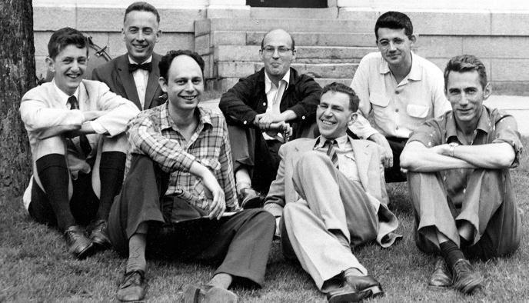
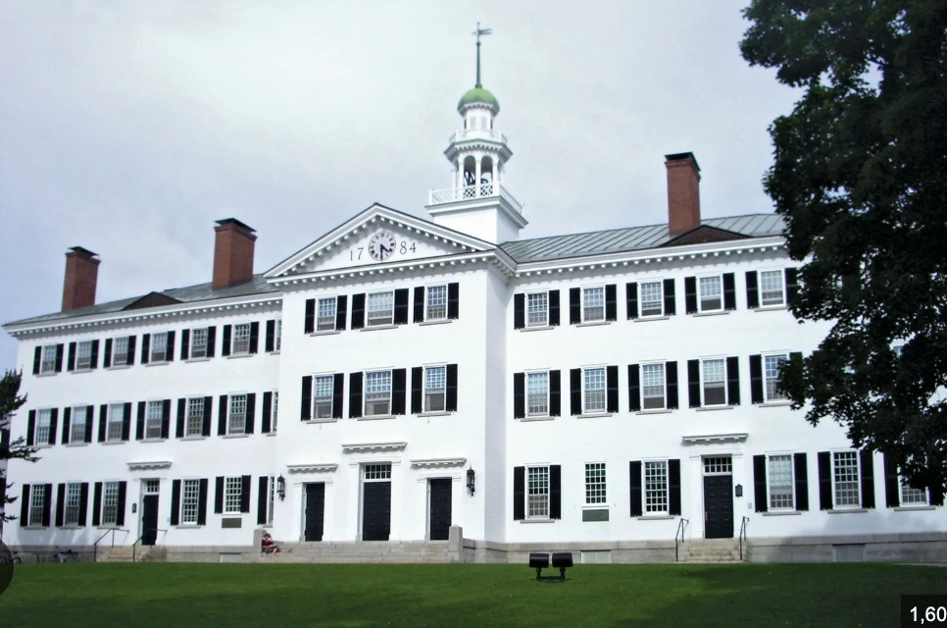

1956
Automatic Computers
How can a Computer be Programmed to use language
Neuron Nets
Theory of the Size of a Calculation
Self-Improvement
Abstractions
Randomness and Creativity
“The study is to proceed on the basis of the conjecture that every aspect of learning or any other feature of intelligence can in principle be so precisely described that a machine can be made to simulate it. An attempt will be made to find how to make machines use language, form abstractions and concepts, solve kinds of problems now reserved for humans, and improve themselves. We think that a significant advance can be made in one or more of these problems if a carefully selected group of scientists work on it together for a summer.”
Darthmouth College
Shannon
Minsky
Rochester
McCarthy
The Birth of AI

Slide 8
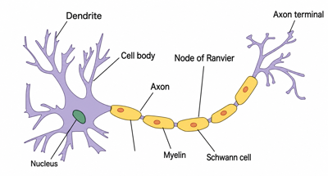
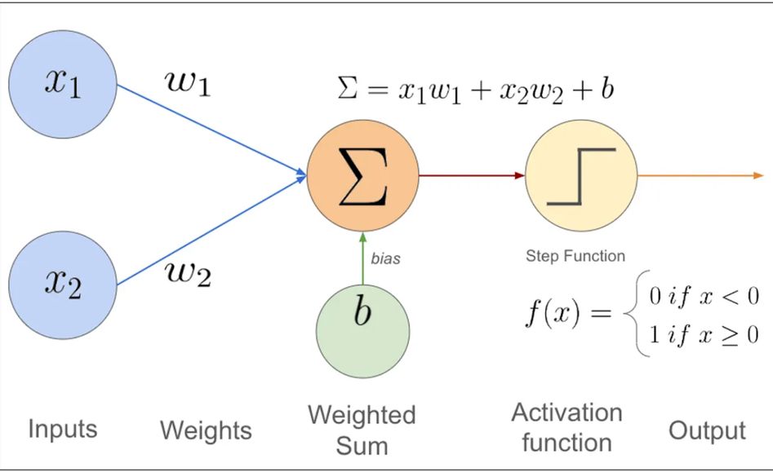
1958
A computational model inspired by the biological operation of neurons in the brain (proposed by Frank Rosenblatt).
A neural network is a distributed parallel processor made up of simple processing units that can store knowledge based on experience and make it available for use.
The network acquires knowledge from the environment through a learning process.
Connections between neurons, or synaptic weights, are used to store the acquired knowledge.
Perceptron

Slide 9

Prolog
1970
Logic programming:
Algorithm = Logic + Control
Many expert systems have been written in Prolog for legal, medical, financial, and other domains.
Prolog programs are sets of positive clauses written in a notation similar to first-order logic.
General-purpose programming language.
Created by Dennis Ritchie at Bell Labs.
It is an imperative, compiled language that provides control statements for:
State Management
Decision-Making
Repetitive Tasks

Slide 10
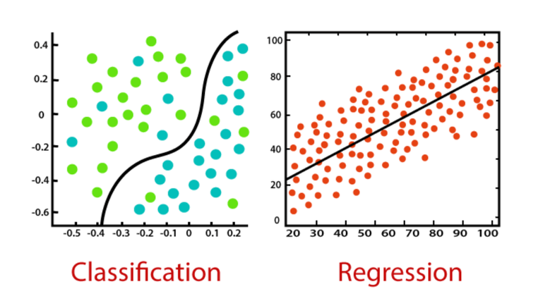
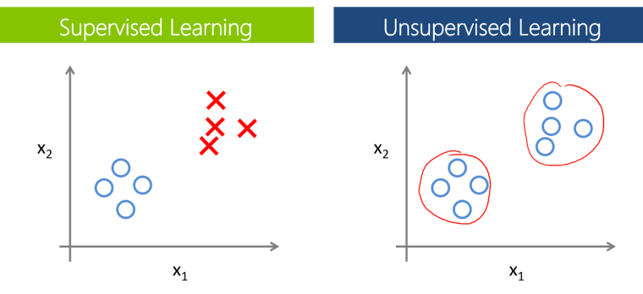
They are mathematical models.
A description of a system or phenomenon using mathematical concepts and languages.
A hypothesis for explaining a phenomenon.
Something we construct, assume, believe, or trust based on a set of rules defined a priori or on observations of the event.
What Is a Model?
How Are They Built?
Formal Methods
First-Order Calculus
Lambda Calculus
Temporal Logic
Rewriting Systems
Causal Calculus
Statistical Methods
Regression Techniques
Classification Techniques
Bayesian Networks
Markov Networks

Slide 11
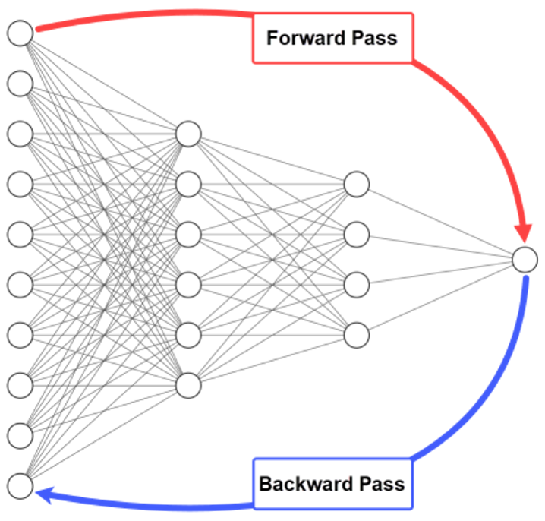
1975
Backpropagation
This algorithm calculates the gradient of the loss function with respect to the weights of each neuron in a neural network.
It made it possible to train more than one neuron connected in series, adding nonlinear behavior that enabled a neural network to solve the XOR problem.

Slide 12
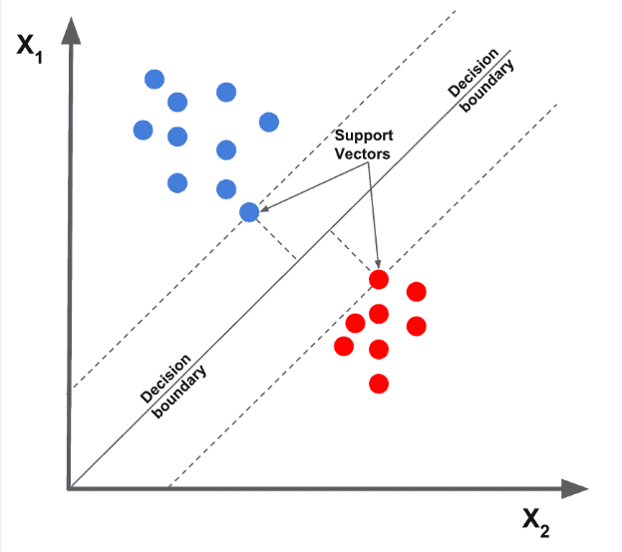
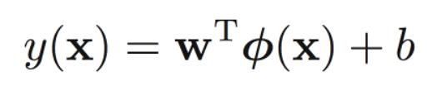
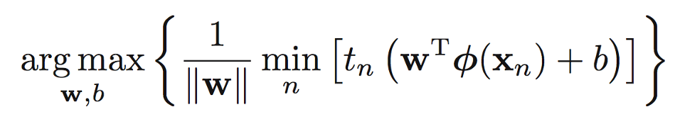
1995
Support Vector Machine
Vladimir Vapnik and his colleagues at AT&T Bell Labs proposed a linear classification algorithm similar to neural networks (the perceptron) that attempts to maximize the margin between two subspaces.
The objective is to maximize:

Slide 13
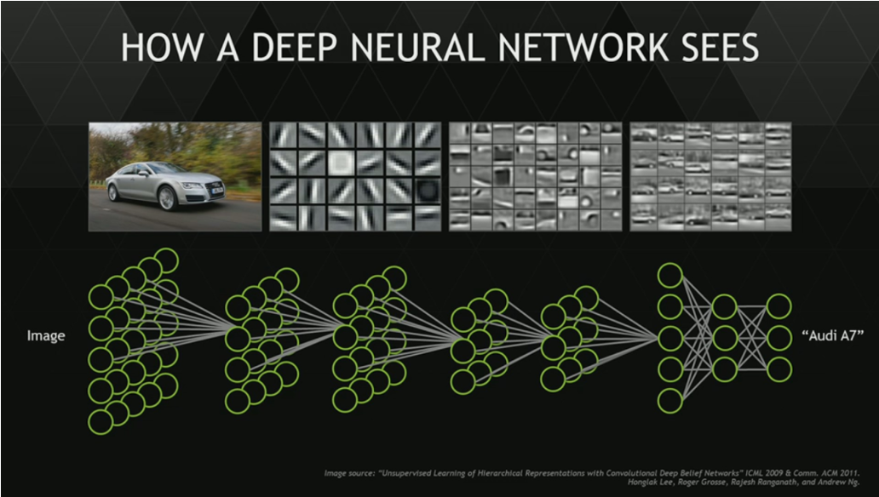
2000
Deep Learning
Although the theoretical tools had been available since the 1960s, the term deep learning was introduced in 1986. Since then, different researchers have simultaneously studied neural networks whose depth (number of layers) can grow.
In particular, the work of Yoshua Bengio, Geoffrey Hinton, and Yann LeCun established the foundations for using a modified error-backpropagation algorithm to train these networks.

Slide 14
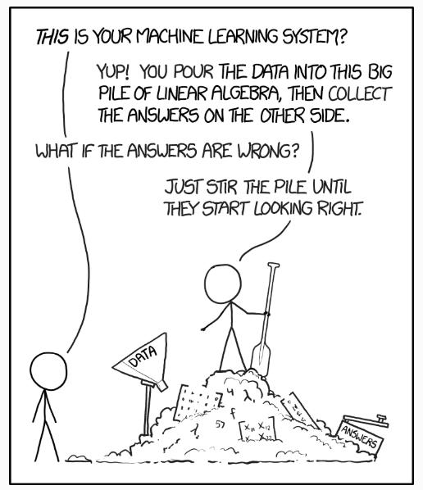
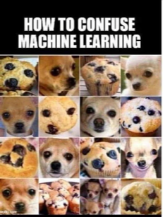
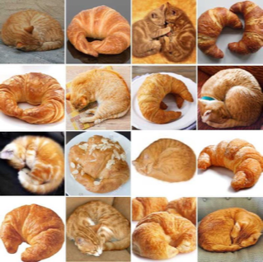
Limitations of Statistical Models

Slide 15
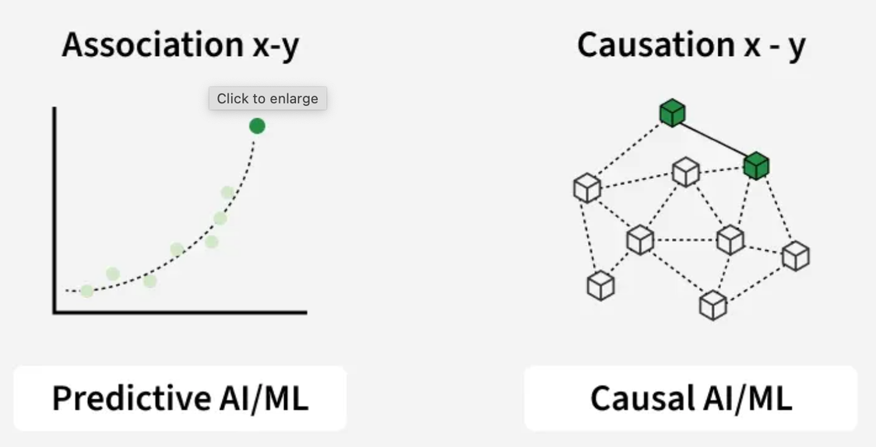
Causal Models
The idea of causality between two phenomena (A and B) is to determine:
Whether A is the cause and B is the effect.
Whether B is the cause and A is the effect.
But not both at the same time.
One theory that promises to connect with ML, and therefore with artificial intelligence, is the Causal Calculus proposed by Judea Pearl (1987). It encodes cause-and-effect relationships among phenomena or events in a Directed Acyclic Graph.

Slide 16
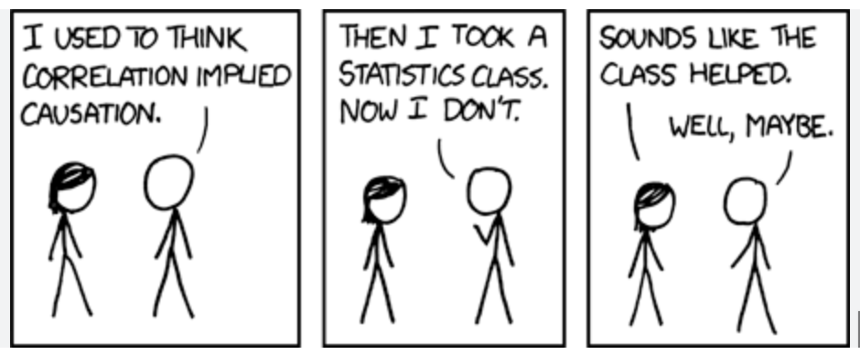
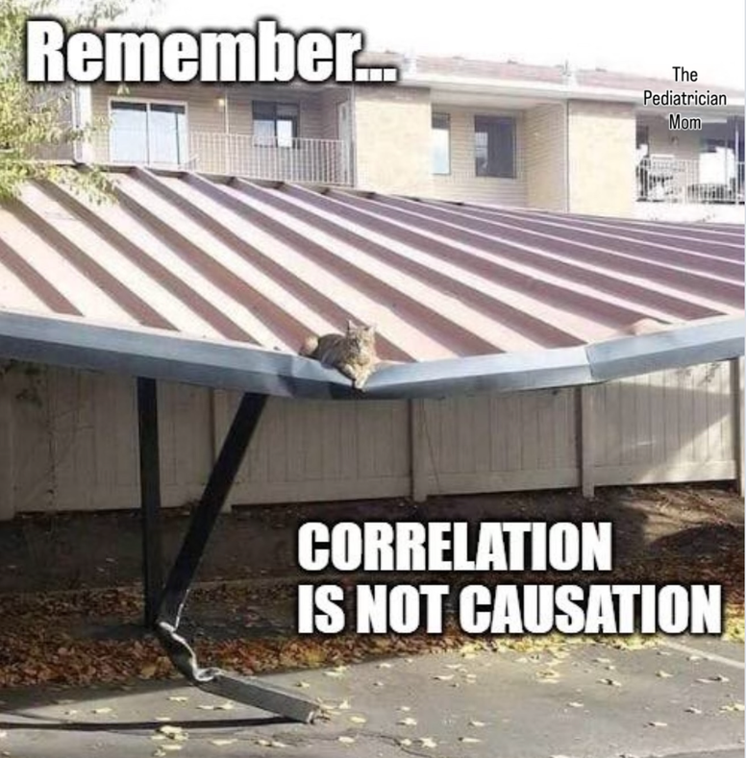
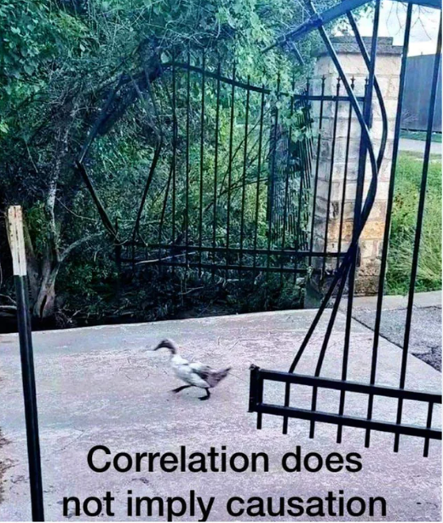

Slide 17
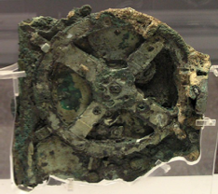
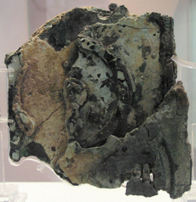
1970-1974
Discovery and Study of a Shipwreck
In 1900, a group of divers recovered artifacts from an ancient shipwreck near the Greek island of Antikythera.
In 1902, Greek archaeologists examined the artifacts and discovered a gear embedded in a rock. They dismissed it because the mechanism seemed too advanced for the period.
In 1951, and again in 1971, its study resumed. After 82 fragments were analyzed with X-rays and gamma rays, researchers began studying this mechanism from approximately 200 BC.

Slide 18
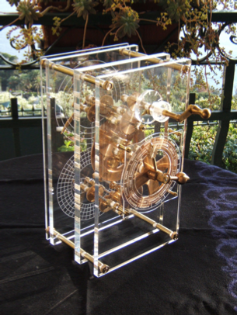
200 BC
It is the earliest known analog computer, capable of calculating and predicting astronomical positions and eclipses up to 19 years ahead.
It could also calculate the dates of six ancient Greek competitions.
This discovery fundamentally challenges the belief that human technological development has always been incremental.
Antikythera Mechanism

Slide 19
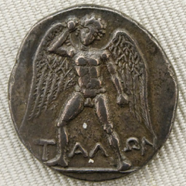
800 BC?
The Iliad describes Talos:
A giant (automaton) made of bronze who protected Europa on Crete from pirates and invaders.

